Slide 1

Case control study

Slide 2
MCQ - 1
Which of the following best describes a cross-sectional study?
a) A study that follows individuals over time to assess changes in their health status.
b) A study that compares the effectiveness of different interventions in a population.
c) A study that collects data from a population at a single point in time.
d) A study that investigates the genetic factors underlying a specific disease.

Slide 3
MCQ - 2
A longitudinal Study is a research design that involves repeated observations of the same variables over short or long period of time. which of the following is false statement about longitudinal study?
a) Helps us study natural history of disease.
b) Helps in identification of risk factor of a disease.
c) Helps us find out rate of occurrence of new cases of a disease.
d) Easy to organize and less time consuming.

Slide 4
MCQ - 3
Descriptive epidemiology contributes in research by:-
a) Establishing causality between risk factors and diseases
b) Providing data on disease occurrence by time, place and person
c) Evaluating the efficacy of different treatment options
d) Identifying individual disease trajectories over time

Slide 5
MCQ - 4
The "O" in PICOTS refers to:
a) Observation
b) Objectives
c) Outcome
d) Opportunity

Slide 6
Introduction
Common first approach to test causal hypothesis
Aka Retrospective studies
Features
Both exposure and outcome (disease) have occurred before the start of the study
The study proceeds backwards from effect to cause
It uses a control or comparison group to support or refute an inference.
In case control studies, the unit is the individual rather than the group.
The focus Is on a disease or some other health problem that has already developed.

Slide 7
Cases & Controls
Cases and controls must be comparable with respect to known “confounding factors” such as age, sex, occupation, social status, etc.
The questions asked relate to personal characteristics and antecedent exposures which may be responsible for the condition studied.
Example - one can use as “cases” the immunized children and use as “controls” un-immunized children and look for factors of interest in their past histories.

Slide 8
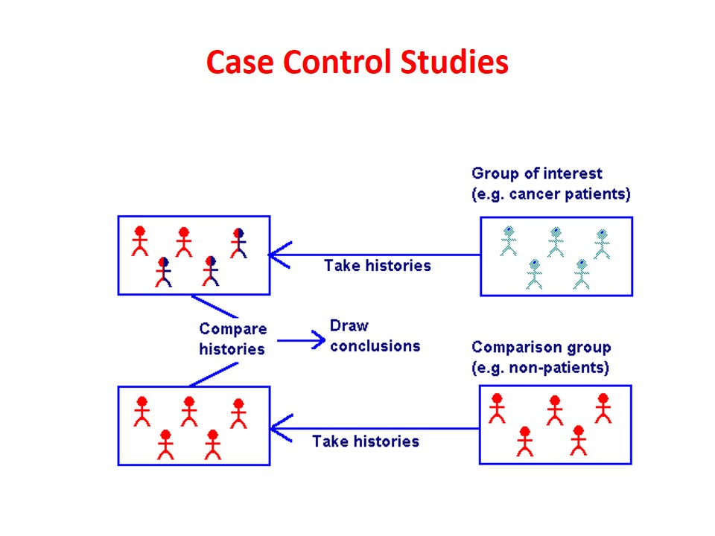
Basic design
Suspected / Risk factors | Cases | Control
Present | a | b
Absent | c | d

Slide 9
Basic steps
Selection of cases and controls
Matching
Measurement of exposure
Analysis and interpretation.

Slide 10
Selection of cases
Definition of a case : The prior definition of what constitutes a “case” is crucial
DIAGNOSTIC CRITERIA : The diagnostic criteria of the disease and the stage of disease, if any (e.g., breast cancer Stage I) to be included in the study must be specified before the study is undertaken.
ELIGIBILITY CRITERIA : A criterion customarily employed is the requirement that only newly diagnosed (incident) cases within a specified period of time are eligible than old cases or cases in advanced stages of the disease (prevalent cases).

Slide 11
Sources of cases
HOSPITALS : It is often convenient to select cases from hospitals. The cases may be drawn from a single hospital or a network of hospitals, admitted during a specified period of time.
The entire case series or a random sample of it is selected for study,
GENERAL POPULATION : In a population-based case control study, all cases of the study disease occurring within a defined geographic area during a specified period of time are ascertained, often through a survey, a disease registry or hospital network. The entire case series or a random sample of it is selected for study. The cases should be fairly representative of all cases in the community.
Cohort – Nested cases control study

Slide 12
Selection of controls
The controls must be free from the disease under study.
They must be as similar to the cases as possible, except for the absence of the disease under study.
As a rule, a comparison group is identified before a study is done, comprising of persons who have not been exposed to the disease or some other factor whose influence is being studied.
Difficulties may arise in the selection of controls if the disease under investigation occurs in subclinical forms whose diagnosis is difficult.

Slide 13
Sources of Control
HOSPITAL CONTROLS: The controls may be selected from the same hospital as the cases, but with different illneses other than the study disease.
Usually it is unwise to choose a control group from a group of patients with one disease. This is because hospital controls are often a source of “selection bias”.
Many hospital patients may have diseases which are also influenced by the factor under study. For example, if one was studying the relationship of smoking and myocardial infarction and chooses bladder cancer cases as controls, the relationship between smoking and myocardial infarction may not have been demonstrated.
Care must be taken when using other patients as comparison subjects, for they differ in many ways from a normal healthy population.
Ideally the controls should have undergone the same diagnostic work-up as cases, but have been found to be negative. But this may not be acceptable to most controls

Slide 14
Sources of Control
RELATIVES : The controls may also be taken up from relatives (spouses and siblings).
Sibling controls are unsuitable where genetic conditions are under study.
NEIGHBOURHOOD CONTROLS : The controls may be drawn from persons living in the same locality as cases, persons working in the same factory or children attending the same school.
GENERAL POPULATION : Population controls can be obtained from defined geographic areas, by taking a random sample of individuals free of the study disease.
We must use great care in the selection of controls to be certain that they accurately reflect the population that is free of the disease of interest.

Slide 15
Validity
Some investigators select cases from one source and controls from more than one source to avoid the influence of “selection bias’’. Such studies are recommended by epidemiologists.
It is also desired to conduct more than one case control study, preferably in different geographic areas.
If the findings are consistent, it serves to increase the validity (i.e., accuracy) of the inferences. Failure to select comparable controls can introduce “bias” into results of case control studies and decrease the confidence one can place in the findings.

Slide 16
Matching
Process by which we select controls in such a way that they are like cases with regard to certain pertinent selected variables (e.g., age) which are known to influence the outcome of disease and which, if not adequately matched for comparability, could distort or confound the results.
Confounding factor
Which is associated both with exposure and disease and is distributed unequally in study and control groups. More specifically a “confounding factor” is one that, although associated with “exposure” under investigation, is itself, independently of any such association, a “risk factor” for the disease.

Slide 17
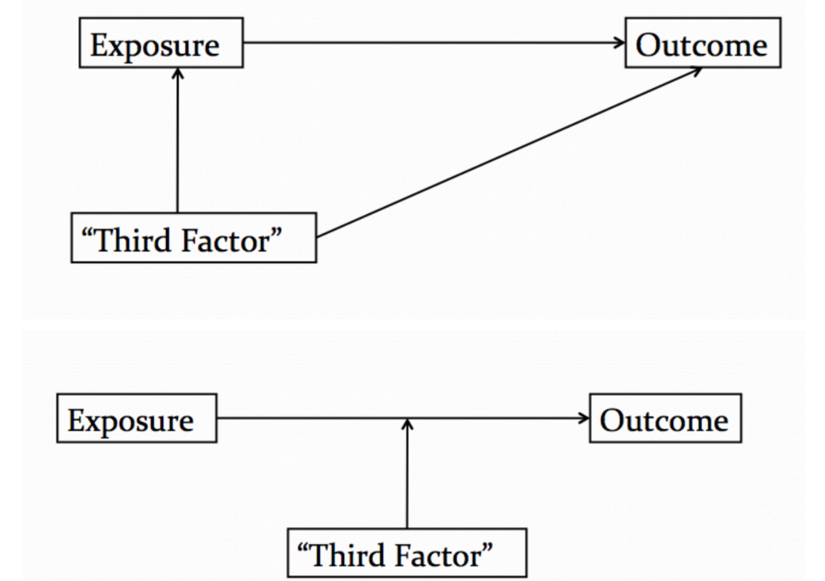
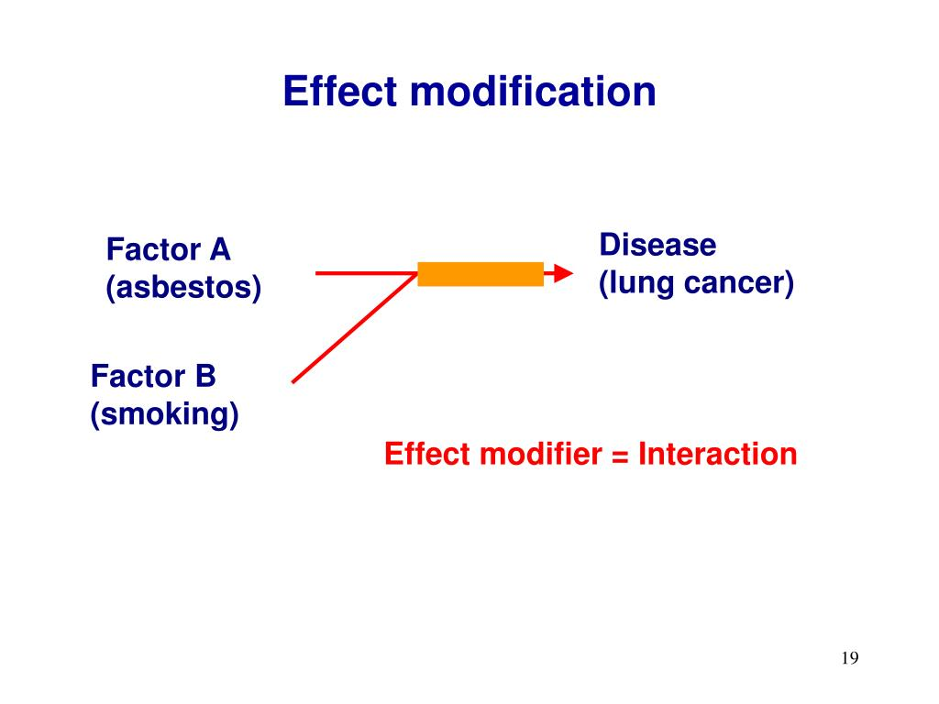
Confounding factor vs Effect modifier

Slide 18
Examples
Role of alcohol in the aetiology of oesophageal cancer, smoking is a confounding factor.
Age could be a confounding variable. Supposing, are investigating the relationship between steroid contraceptive and breast cancer. If the women taking these contraceptives were younger than those in the comparison group, they would necessarily be at lower risk of breast cancer since this disease becomes increasingly common with increasing age.
Matching protects against an unexpected strong association between the matching factor (e.g., age) and the disease (e.g., breast cancer). In a similar fashion other confounding variables will have to be matched.
It should be borne in mind that the suspected aetiological factor or the variable we wish to measure should not be matched, because by matching, its aetiological role is eliminated in that study. The cases and controls will then become automatically alike with respect to that factor.
In the above example, it would be useless tomatch cases and controls on steroid contraceptive use; bydoing so, the aetiological role of steroid contraceptivecannot be investigated.

Slide 19
Matching procedure
One is group matching. This may be done by assigning cases to sub-categories (strata) based on their characteristics (e.g., age, occupation, social class) and then establishing appropriate controls. The frequency distribution of the matched variable must be similar in study and comparison groups.
Matching is also done by pairs. For example, for each case, a control is chosen which can be matched quite closely. Thus, if we have a 50 year old mason with a particular disease, we will search for 50 year old mason without the disease as a control. But there may be great difficulties in obtaining cases and controls matched on all characteristics, and it may be necessary to wait a considerable period of time before obtaining a sufficient number of matched pairs.
Therefore, some leeway is necessary in matching for variables. It should be noted that if matching is overdone, it may be difficult to find controls. Further with excess zeal in matching, there may be a tendency to reduce the odds ratio.

Slide 20
Measurement of exposure
Definitions and criteria about exposure (or variables which may be of aetiological importance) are just as important as those used to define cases and controls.
Information about exposure should be obtained in precisely the same manner both for cases and controls.
It is important to recognize that when case control studies are being used to test associations, the most important factor to be considered, even more important than the P. values obtained, is the question of “bias” or systematic error which must be ruled out.

Slide 21
Analysis - Exposure rate
A case control study provides a direct estimation of the exposure rates (frequency of exposure) to a suspected factor in disease and non-disease groups.
The next step will be to ascertain whether there is a statistical association between exposure status and occurrence of lung cancer. This question can be resolved by calculating the P value.
The particular test of significance will depend upon the variables under investigation. If we are dealing with discrete variables, the results are usually presented as rates or proportions of those present or absent in the study and in the control group. The test of significance usually adopted is the standard error of difference between two proportions or the Chi-square test.
On the other hand, if we are dealing with continuous variables (e.g., age, blood pressure), the data will have to be grouped and the test of significance used is likely to be the standard error of difference between two means.
Statistical association (P. value) does not imply causation. Statement of P value is thus an inadequate, although common end-point of case control studies.

Slide 22
Estimation of risk
The estimation of disease risk associated with exposure is obtained by an index known as “Relative Risk” (RR) or “risk ratio”, which is defined as the ratio between the incidence of disease among exposed persons and incidence among non-exposed.
A typical case control study does not provide incidence rates from which relative risk can be calculated directly, because there is no appropriate denominator or population at risk, to calculate these rates. In general, the relative risk can be exactly determined only from a cohort study.
Odds ratio aka cross product ratio

Slide 23
ODDS ratio
From a case control study, we can derive what is known as Odds Ratio (OR) which is a measure of the strength of the association between risk factor and outcome.
Odds ratio is closely related to relative risk.
The derivation of odds ratio is based on three assumptions :
The disease being investigated must be relatively rare;
The cases must be representative of those with the disease,
The controls must be representative of those without the disease.

Slide 24
BIAS
Bias is any systematic error in the determination of the association between the exposure and disease.
The relative risk estimate may increase or decrease as a result of the bias;
It reflects some type of non-comparability between the study and control groups. The possibility of bias must be considered when evaluating a possible cause and effect relationship.
Selection Bias
Berkesonian Bias : The bias arises because of the different rates of admission to hospitals for people with different diseases
Detection Bias
Information Bias
Recall Bias
Family information bias
Interviewer Bias
Confounding

Slide 25
Advantages
Relatively easy to carry out.
Rapid and inexpensive (compared with cohort studies).
Require comparatively few subjects.
Particularly suitable to investigate rare diseases or diseases about which little is known.
A disease which is rare in the general population (e.g., leukaemia in adolescents) may notbe rare in special exposure group (e.g. prenatal X-rays).
No risk to subjects.
Allows the study of several different aetiological factors (e.g., smoking, physical activity and personality characteristics in myocardial infarction).
Risk factors can be identified. Rational prevention and control programmes can be established.
No attrition problems, because case control studies do not require follow-up of individuals into the future.
Ethical problems minimal.

Slide 26
Disadvantages
Problems of bias relies on memory or past records, the accuracy of which may be uncertain; validation of information obtained is difficult or sometimes impossible.
Selection of an appropriate control group may be difficult.
We cannot measure incidence, and can only estimate the odds ratio
Do not distinguish between causes and associated factors.
Not suited to the evaluation of therapy or prophylaxis of disease.
Another major concern is the representativeness of cases and controls.

Slide 27

Cohort study

Slide 28
Elements
Selection of study subjects
Obtaining data on exposure
Selection of comparison groups
Follow-up
Analysis.

Slide 29
Selection of study subjects
General population
Exposure or cause of death is fairly frequent in the population
Residing in well defined geographical, political and administrative areas
If the population is very large, an appropriate sample is taken.
The exposed and unexposed segments of the population to be studied should be representative of the corresponding segments of the general population.

Slide 30
Selection of study subjects (Special groups)
Select group
These may be professional groups (e.g., doctors, nurses, lawyers, teachers, civil servants), insured persons, obstetric population, college alumni, government employees, volunteers, etc.
Doll’s prospective study on smoking and lung cancer was carried out on British doctors listed in the Medical Register of the UK in 1951.
These groups are not only homogeneous, but they also offer advantages of accessibility and easy follow-up for a protracted period
Exposure groups :
If the exposure is rare, a more economical procedure is to select a cohort of persons known to have experienced the exposure.
A readily accessible source of these groups is workers in industries and those employed in high-risk situations (e.g., radiologists exposed to X-rays).
When cohorts have been selected because of special exposure, it facilitates classification of cohort members according to the degree or duration of exposure to the suspected factor for subsequent analytical study.

Slide 31
Data on exposure
Cohort members : through personal interviews or mailed questionnaires.
Review of records: Certain kinds of information (e.g., dose of radiation, kinds of surgery, or details of medical treatment) can be obtained only from medical records,
Medical examination or special tests : Some types of information can be obtained only by medical examination or special tests, e.g., blood pressure, serum cholesterol, ECG.
Environmental surveys : This is the best source for obtaining information on exposure levels of the suspected factor in the environment where the cohort lived or worked.
Classification of cohort members :
According to whether or not they have been exposed to the suspected factor, and
According to the level or degree of exposure, at least in broad classes, in the case of special exposure groups
Basic information about demographic variables which might affect the frequency of disease under investigation, should also be collected. Such information will be required for subsequent analysis.

Slide 32
Comparison groups
Internal comparison
External comparison
When information on degree of exposure is not available, it is necessary to put up an external control, to evaluate the experience of the exposed group, e.g., a cohort of radiologists compared with a cohort of ophthalmologists, etc.
The study and control cohorts should be similar in demographic and possibly important variables other than those under study.

Slide 33
Comparison groups
Comparison with general population rates
If none is available, the mortality experience of the exposed group is compared with the mortality experience of the general population in the same geographic area as the exposed people
Rates for disease occurrence in sub-groups of the control cohort by age, sex, and other variables considered important may be applied to the corresponding sub-groups of the study cohort (exposed cohort) to determine the “expected” values in the absence of exposure.
The ratio of “observed” and “expected” values provides a measure of the effect of the factor under study.
The limiting factors in using general population rates for comparison are :
(i) non-availability of population rates for the outcome required;
(ii) the difficulties of selecting the study and comparison groups which are representative of the exposed and non-exposed segments of the general population.

Slide 34
Follow up
The procedures required comprise :
Periodic medical examination of each member of the Cohort
Reviewing physician and hospital records
Routine surveillance of death records
Mailed questionnaires, telephone calls, periodic home visits - preferably all three on an annual basis.
Of the above, periodic examination of each member of the cohort, yields greater amount of information on the individuals examined, than would the use of any other procedure.
Certain percentage of losses to follow-up are inevitable due to death, change of residence, migration or withdrawal of occupation. These losses may bias the results. It is, therefore, necessary to build into the study design a system for obtaining basic information on outcome for those who cannot be followed up in detail for the full duration of the study.
The safest course recommended is to achieve as close to a 95 per cent follow-up as possible

Slide 35
Thanks

